Slide 1


Digital Vehicle Twin Simulation
Center for Automated Driving and Service Technology (CAST)
Project Mentor: Prof. Dr. Ing. Ralf Schuler
Team: Keshav Sundar Venkateswaran, Raj Srivastava, Shikhar Rupesh Takke, Neil Ponsonnard

Slide 2

Contents
Objectives
Project Workflow
Model Development
Results

Slide 3
Objectives
Develop a digital twin of a 1:14 scale vehicle using Simscape Multibody.
Model key physical aspects, including:
Vehicle geometry
Suspension and Steering behaviour
Simplified electric drive system
Implement a Model-Based Systems Engineering (MBSE) workflow.
Create a logical system architecture that:
Supports simulation execution
Serves as project documentation and reference.
Support future development and validation of autonomous driving functions within a miniature traffic environment at the CAST lab using the digital twin.

Slide 4
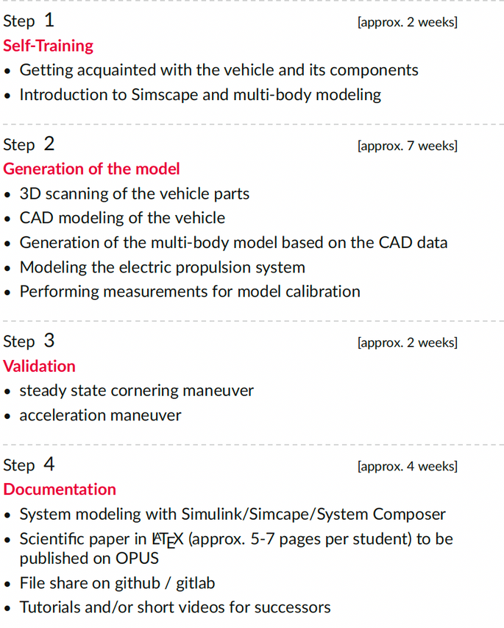
Project Workflow

Slide 5
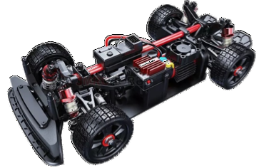
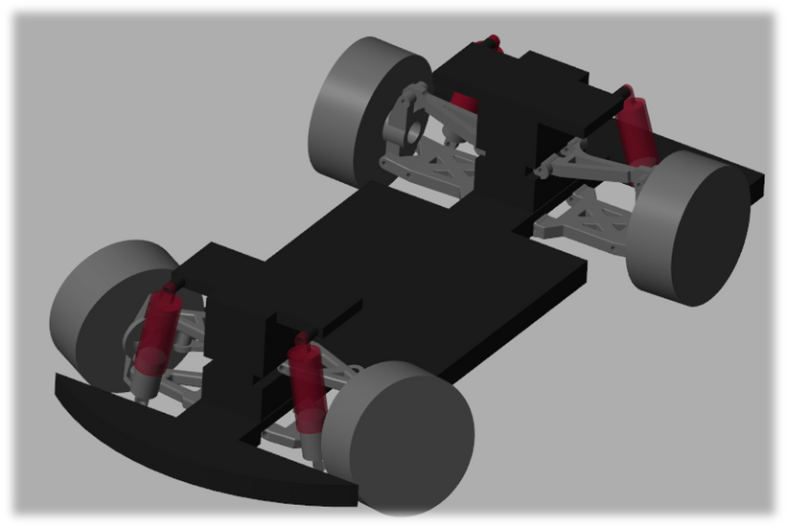
Model Vehicle
Actual Vehicle
Assembled Multibody Model

Slide 6
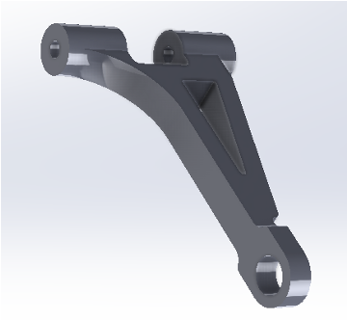
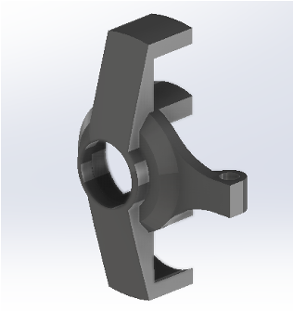
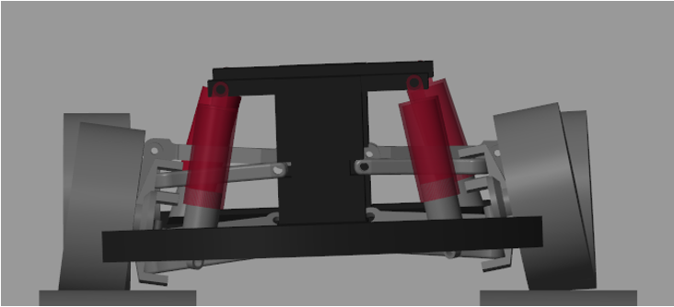
Model Vehicle

Slide 7
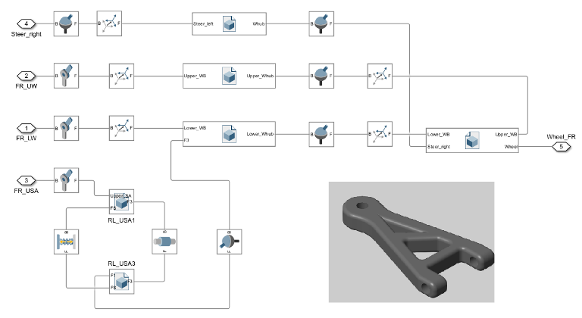
Simscape Model

Slide 8
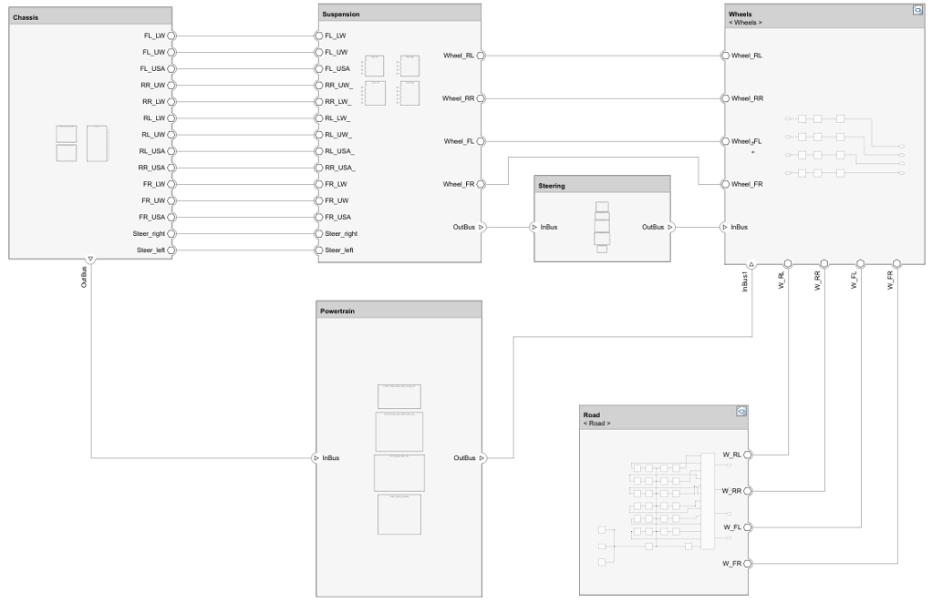
System Composer

Slide 9

Results
A benchmark vehicle simulation model was successfully developed, enabling validation of autonomous driving features in a controlled environment.
System Composer was evaluated and proven to be a tool with possible scope for both:
Executing real-time simulations
Serving as an integrated platform for system documentation
A detailed electric powertrain model can further be developed in Simulink and integrated with the existing multibody vehicle model, facilitating comprehensive full-system simulations and virtual test drives.

Slide 10
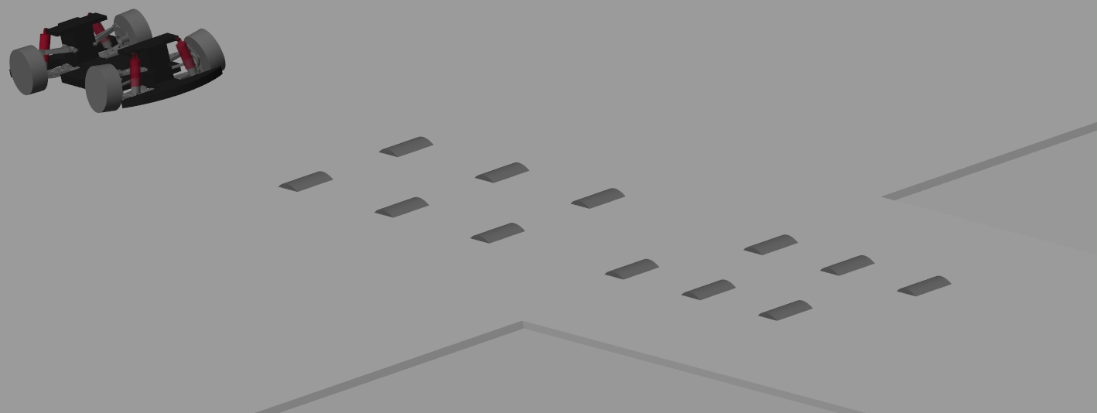
Results

Slide 11

Results

Slide 12

Thank You

